Slide 1



Python Tsunami
– April 21st-23rd –

Slide 2




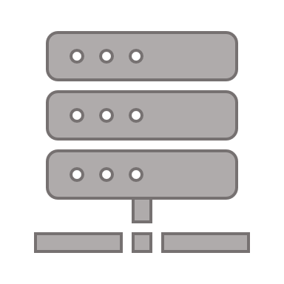



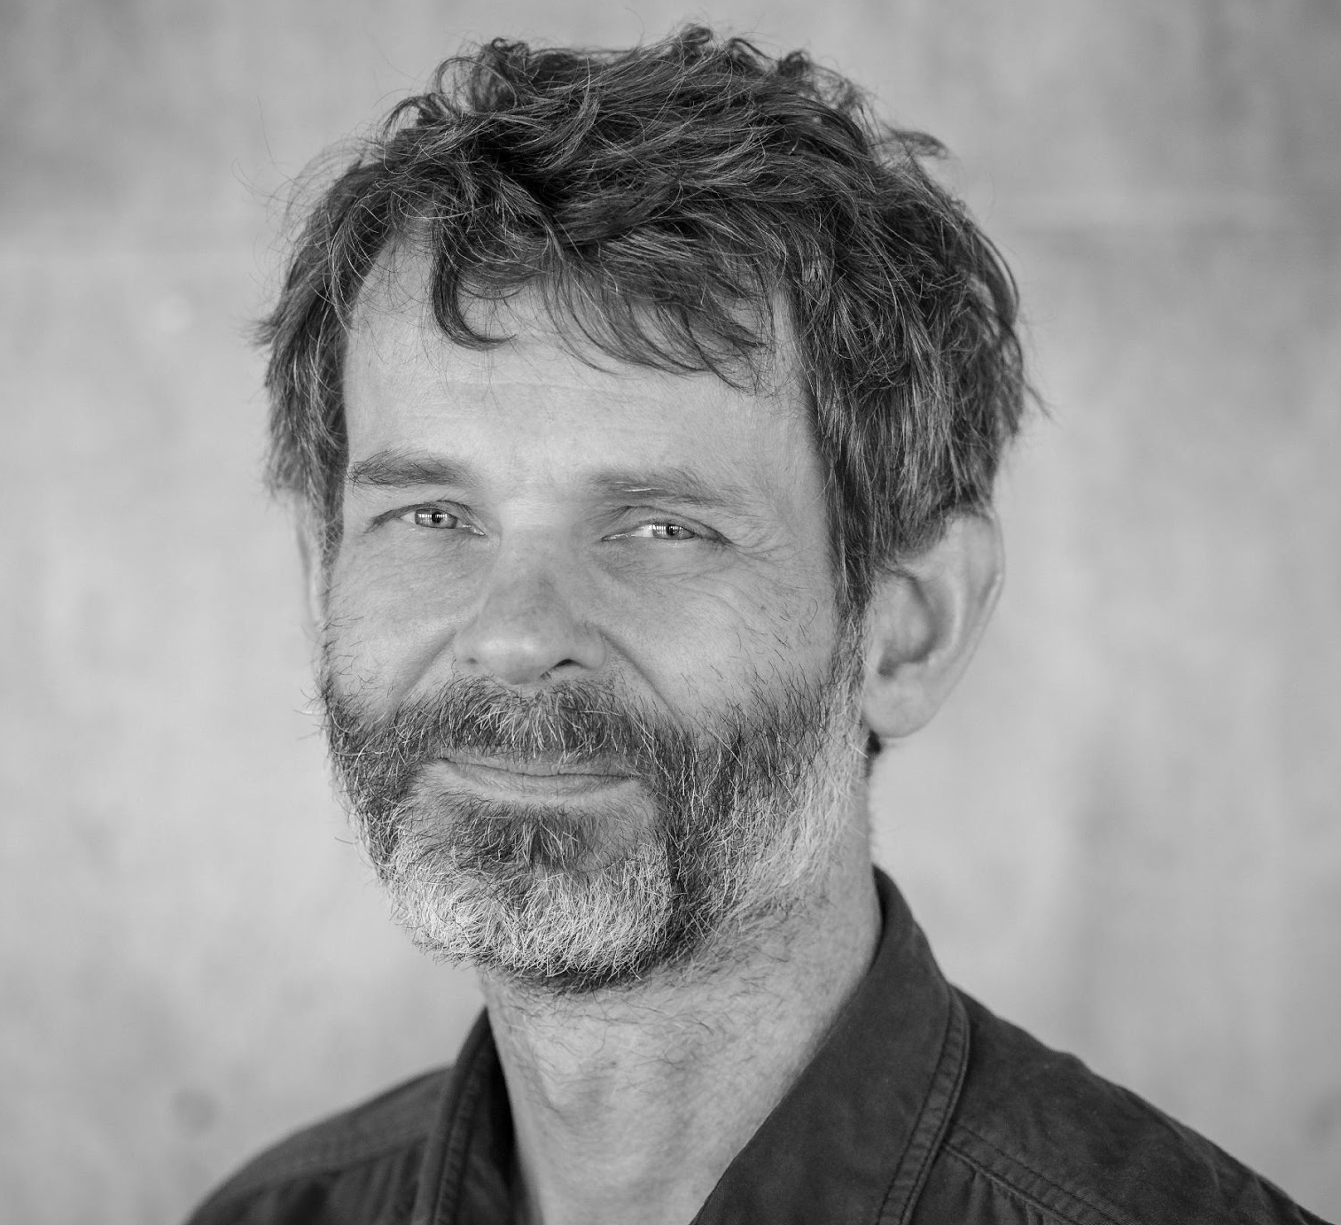
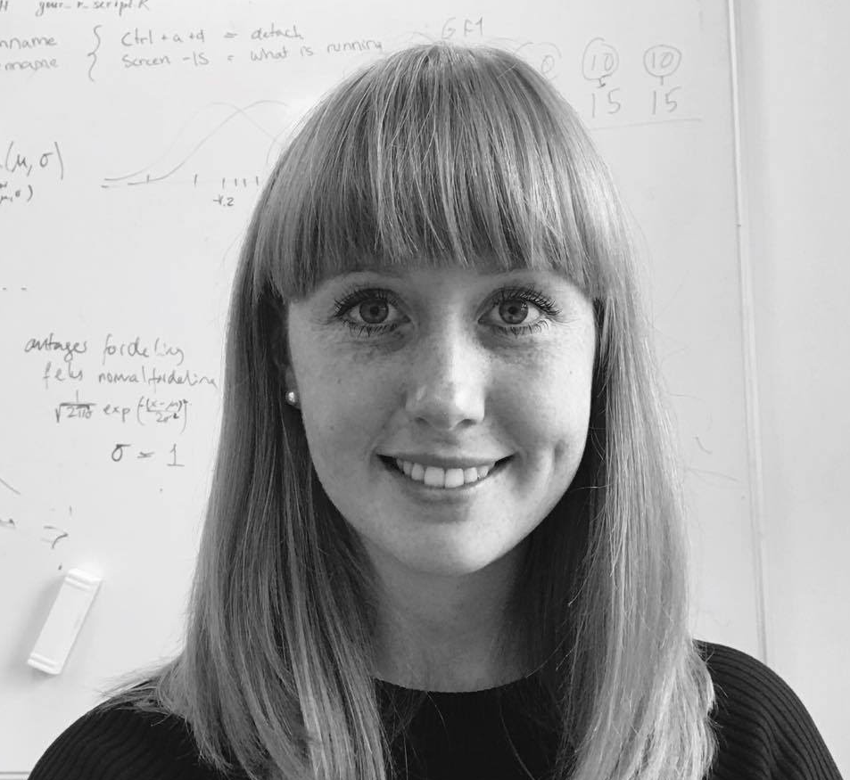
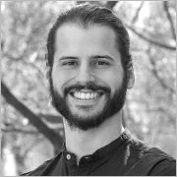
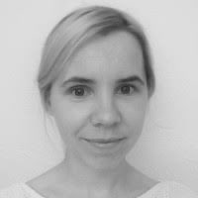


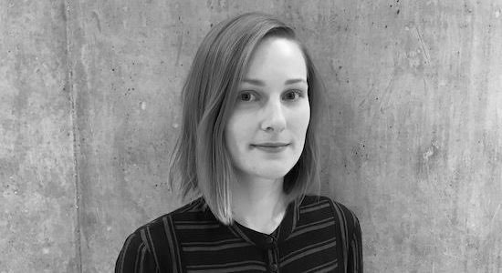
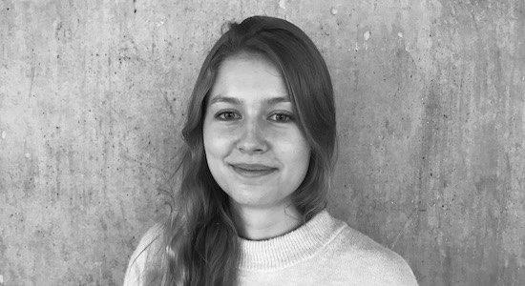

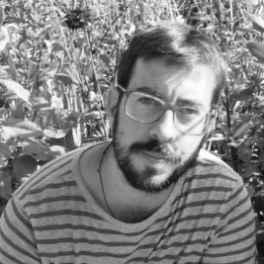
Center for Health Data Science (HeaDS)
https://heads.ku.dk
The Data Science lab:
Provides data science support for all research groups at SUND
Organizes courses
Research units:
work on different areas and topics within the field of health data science

Slide 3


The Team
Alberto Santos (HeaDS)
Annelaura Bach Nielsen (NNF CPR)
Davide Placido (NNF CPR)
Henry Webel (NNF CPR)
Marilena Hohmann (HeaDS)
Philip Charles (DBI (Oxford, UK))
‪Rita Colaço (PRI)
Roc Reguant (NNF CPR)
Thilde Terkelsen (HeaDS)

Slide 4
Other Members of the Team
Dhouha Grissa (NNF CPR)
Grzegorz Jerzy Maciag (BRIC)
Jose Alejandro Romero Herrera (HeaDS)
Katerina Nastou (NNF CPR)
Kübra Altinel (BRIC)
Marta Matos (GENOME Center)
Nicholas Luke Cowie (DTU)

Slide 5
Practical Things about the Course
Program
Coffee and Q&A
Teams
Breakout rooms
Datathon

Slide 6
Practical Things about the Course -- Program --
 | Wednesday 21st April | Thursday 22nd April | Friday 23rd Friday
8:45-9:00 |  | Coffee and the day before (optional)
9:00-09:45 | Introduction and motivation | Conditions | Visualization I
9:45-10:00 | Coffee break
10:00-11:00 | Installation and tools | Loops | Visualization II
11:00-12:00 |  | Functions
 |  |  | Introduction Datathon
12:00-13:00 | Lunch break
13:00-14:00 | Variables and data types | Libraries | Datathon
14:00-14:45 | Numbers and operators | Scientific python
14:45-15:15 | Coffee break
15:15-16:00 | Data structures | Pandas | Datathon
16:00-17:00 |  |  | Presentations
17:00-17:30 | Q&A |  | What else is there?

Slide 7
Practical Things about the Course -- Teams --
49 participants divided into 10 fixed teams
2 working modes:
Individual: exercises
Teamwork: discussions, practice and the Datathon

Slide 8
Practical Things about the Course -- Breakout Rooms --
Main room
Chat
TCH
TA
x 3
Teamwork rooms x 10

Slide 9
Practical Things about the Course -- Datathon --
A Datathon is a data-focused competition — given a dataset and a limited amount of time, participants are challenged to use their creativity and data science skills to:
Build
Dataset
Test
Solutions
Explore

Slide 10
Practical Things about the Course -- Datathon --
A Datathon is a data-focused competition — given a dataset and a limited amount of time, participants are challenged to use their creativity and data science skills to:
Build
Dataset
Test
Solutions
Explore

Slide 11
What will you learn in this course?
Tools to work with Python
The basics of Python
Some of the most relevant scientific libraries
Visualization
Good practice

Slide 12
Motivation
Why will programming help you?
Programming is yet another laboratory technique
It helps you automate processes that you need to repeat again and again
It will save you time
It gives you freedom to process, analyze and plot your data as you want
It will help you demystify bioinformatics
It will facilitate communication with bioinformaticians
It will improve your CV

Slide 13
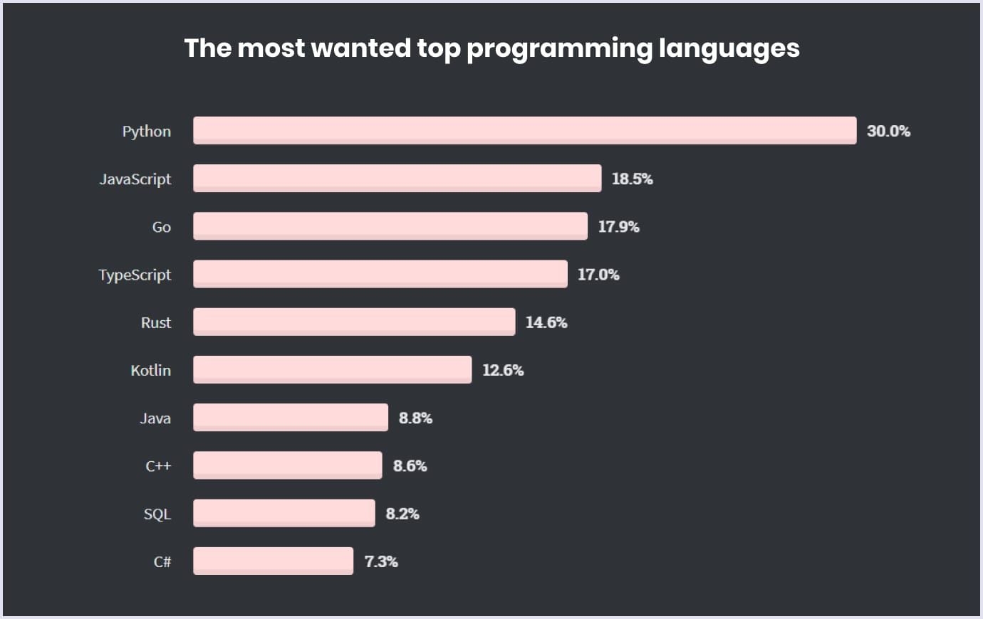
Why Python?
Python is easy to use, powerful, and versatile
A great choice for beginners and experts alike
Python’s readability makes it a great first programming language
It has a huge community behind developing useful libraries in many different fields (i.e biology, imaging, etc.)

Slide 14
Basic concepts
What’s programming?
Variables, Functions
How do you approach a problem?
Car example
Class, Object, attribute, functions

Slide 15
What’s programming
Programming is a way of communicating with a device: computer, cellphone, …, machine of any kind
This communication is possible if you speak a language that the machine understands
Programming is not difficult, mastering it might be a bit more challenging

Slide 16
Variables
variable_name = value
Variable is a way of storing values that you want to use later
To define variables, we use name of variable and ‘=‘ to assign values:
my_first_variable = 3
Variables can have different types:
my_first_variable = 3 # integer
my_second_variable = “This is my second variable” # string
my_third_variable = 3.0 # float

Slide 17
Functions
Function is the way to define actions, i.e sum, print on the screen.
To define functions, we use the reserved word def:
def sum_two_numbers(a, b):
return a + b
def say_hi():
print(“Hi”)
Functions can be called by their name and specifying the parameters:
sum_two_numbers(a=7, b=5)
> 12
say_hi()
> Hi
def function_name (parameters)

Slide 18
Strategy for Programming
Problem
Divide and conquer
subproblem
subproblem
subproblem

Slide 19
The Car Problem
Describe this object:
Parts: wheels, a stirring wheel, a frame, etc.
Actions: moves, breaks, etc.
Describe a car
Problem
subproblem
subproblem
subproblem

Slide 20
The Car Problem
Describe this object → Class:
Parts: wheels, a stirring wheel, a frame, etc. → variables or attributes
Actions: start, change gear, etc. → functions
Describe a car
Problem
Variables:
color = “blue”
number_of_wheels = 4
motor = True
power = “gas”
gear = None
Functions:
def start_engine():
. . .
def change_gear(gear):
. . .
subproblem
subproblem
subproblem

Slide 21


Coffee with your team
Introduce yourself and what you do
Explain your motivation to take the course
Discuss what data could be relevant for you

